Slide 1
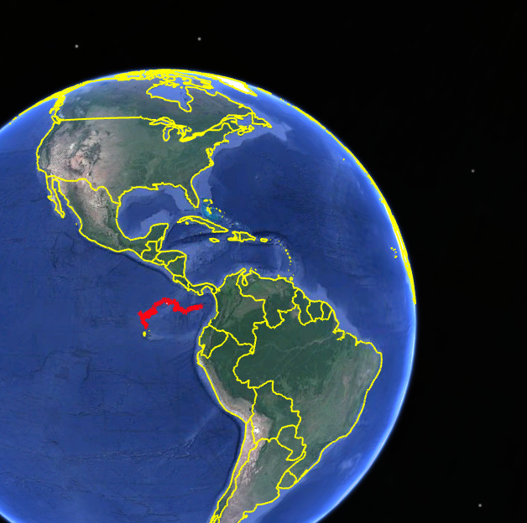
NAUTICAL NETWORK
Open Ocean
Where do sharks like to go?

Slide 2
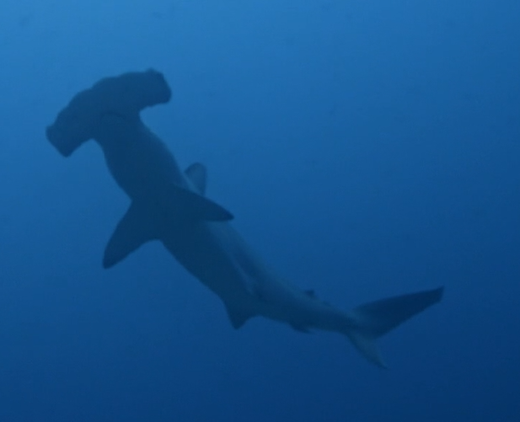
Here’s your challenge:
Track two sharks using Google Earth.
Here’s your to-do list:
Step 1
Download the Shark Tracking Data files for Google Earth.
Step 2
Learn a bit about blacktip and scalloped hammerhead sharks.
Step 3
Find out where the blacktip shark goes using Google Earth.
Step 4
Find out where the scalloped hammerhead shark goes using Google Earth.
You need more than one file to do this activity!
Click here to get the Shark Tracking Data files from the “KML Files” folder.
Step 5
Compare the movements of the two sharks.

Slide 3
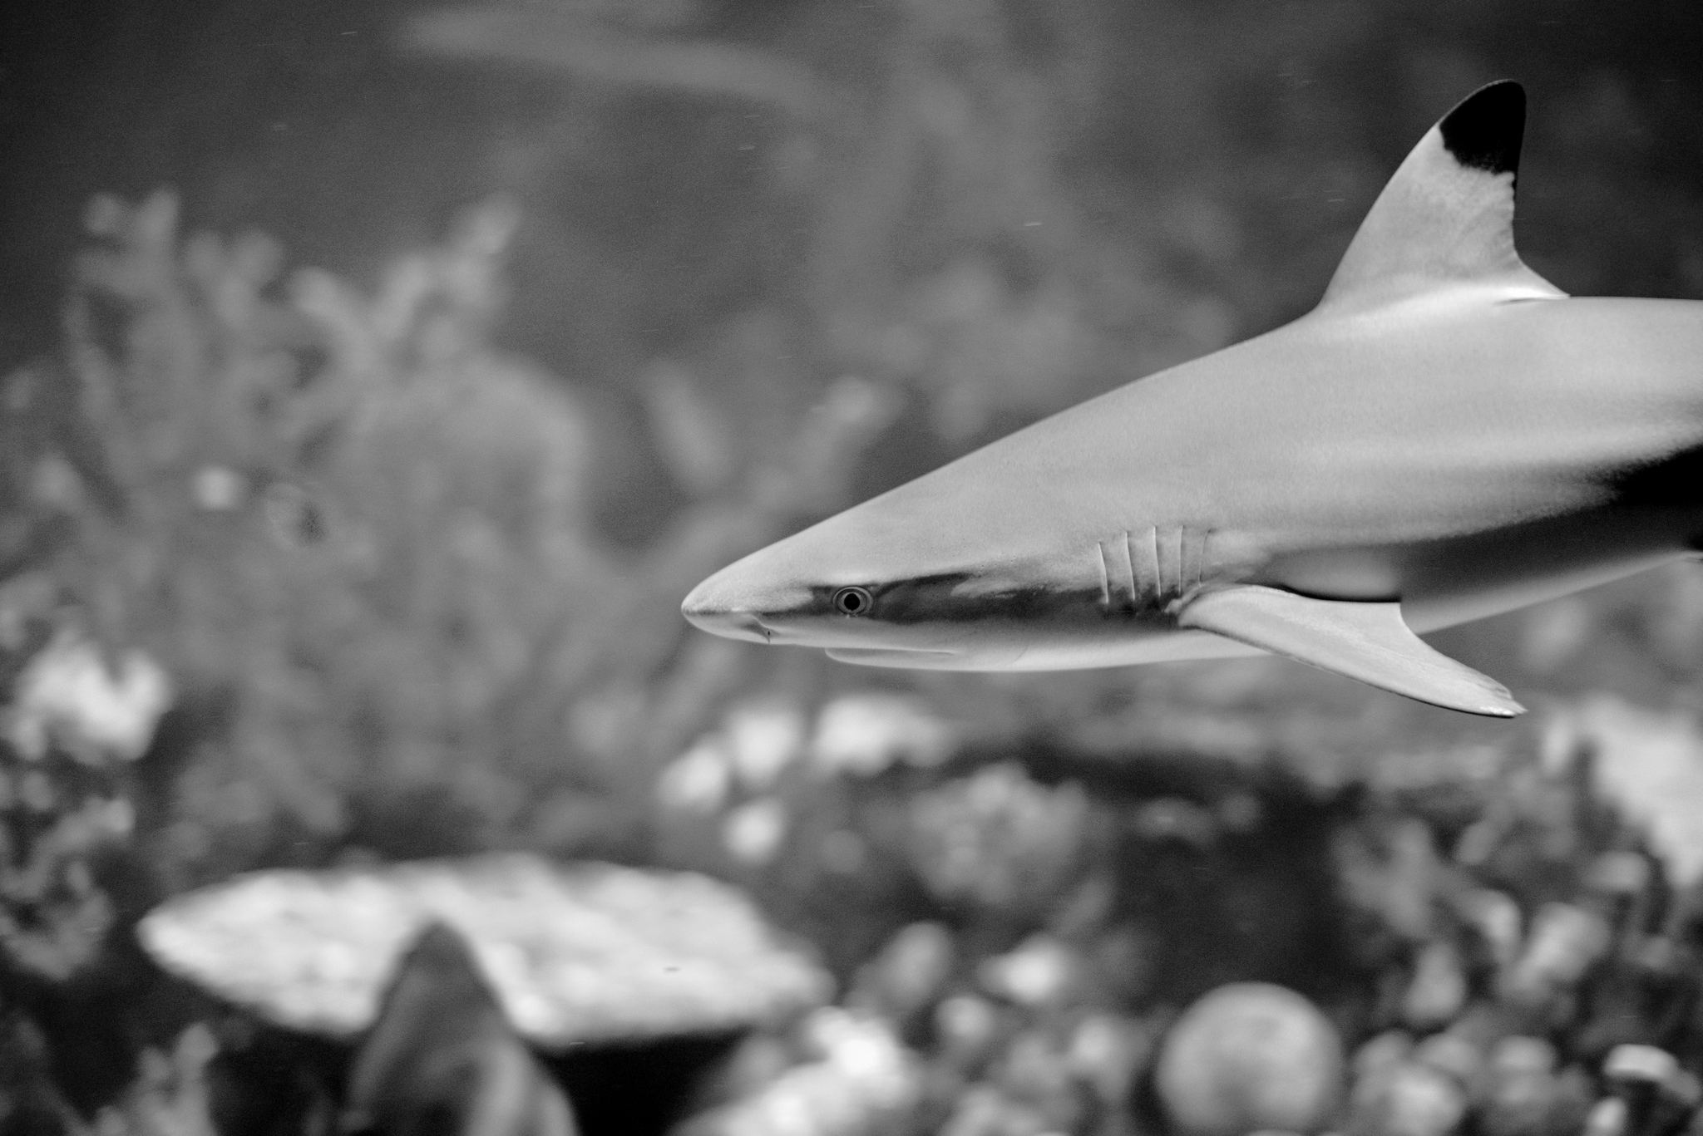
Fast facts: Blacktip Shark
Critical habitat | Blacktip Sharks can be found in the tropical, warm waters of the Pacific, Atlantic, and Indian Ocean.
Diet | They primarily feed on small fish.
Size | Adults can grow up to 2m and can give birth to 1-10 sharks in a litter.
Data collection | The Blacktip Shark data was collected using acoustic tags and receivers. This Blacktip was tagged with an external acoustic tag by a freediver on April 5, 2012. It first “pinged” a receiver on April 25, 2012. Its last ping was on September 3, 2012.
Scientific name: Carcharhinus limbatus
Status: Near threatened
Notes:
Information reference: http://migramar.org/hi/en/assembly-members/hearn/ Image reference: "Blacktip Reef Shark @ Baltimore Aquarium" (CC BY-SA 2.0) by jbylund

Slide 4
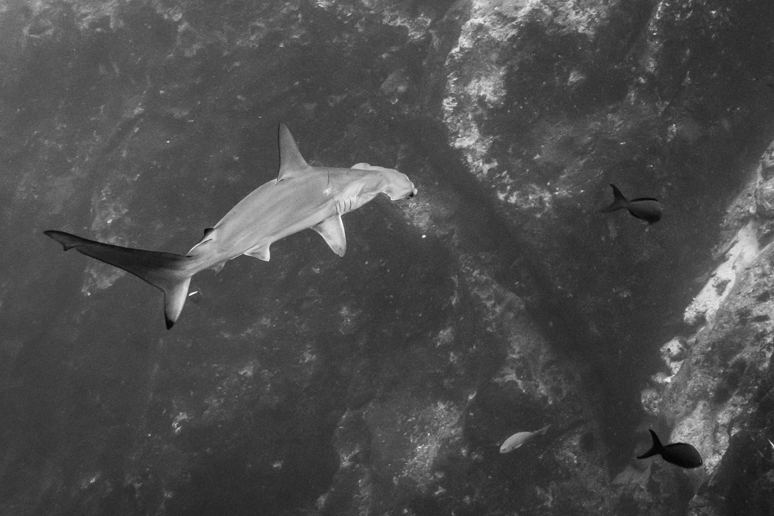
Fast facts: Scalloped Hammerhead Shark
Critical habitat | Considered to be the most common hammerhead shark, Scalloped Hammerheads can be found in the Pacific, Atlantic, and Indian Ocean.
Diet | They have a varied diet of fish, squid, crustaceans, and stingrays.
Size | Adults, reaching 2-3m in length, will roam open waters, but give birth to pups in coastal waters.
Data collection | The hammerhead data was collected using a satellite tag that communicated with the Argos Satellite System. Thank you to Dr. Alex Hearn for sharing this data with Ocean School!
Scientific name: Sphyrna lewini
Status: Critically endangered
Notes:
Information reference: http://migramar.org/hi/en/assembly-members/hearn/

Slide 5
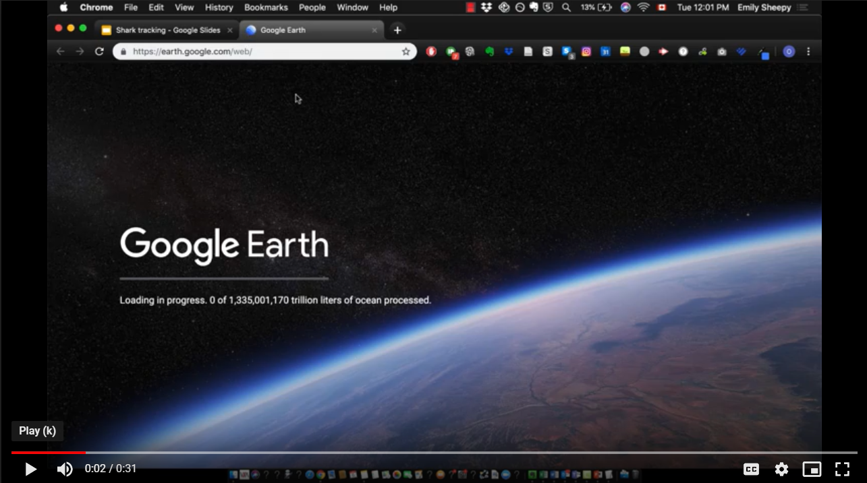
Opening the Blacktip Shark tracks in Google Earth
Download the kml files.
Click here to visit Google Earth in the Chrome browser.
Turn on the “Enable KML Import” setting:
Click the three lines at the top left.
Click "Settings" and scroll to the bottom.
Click the "Enable KML Import" button.
Click the three lines in the top left
Click the "My Places" button
Click "Import KML File" and select the Blacktip KML file that you downloaded
💡
Tip
Click the image to watch a video demo.
Did you know?
A KML file is a special file format used by Google Earth to display geographic data in your web browser.
If you open a KML file in a text editor, it looks a lot like HTML.

Slide 6
Explore the Blacktip Shark data
How far would a blacktip need to travel all the way around Cocos Island, starting from Alycone?
Measuring the area or perimeter:
Select the ruler tool.
Click to choose a starting point.
Keep clicking! Create a closed shape by joining multiple lines together.
Click Done.

Slide 7
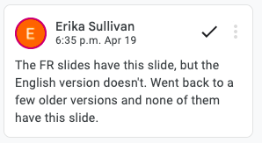
Explorer les données portant sur le Requin bordé
Quelle distance sépare le récepteur acoustique d’Alycone et celui de
Las Gemelas 2?
Faites l’essai!
Effectuez un zoom avant ou arrière en vous servant des commandes + et – qui se trouvent dans le coin inférieur droit de l’écran.
Voyez-vous une chaîne de montagnes sous-marine à proximité de l’île Cocos? Basculez en 3D pour obtenir une vue latérale de la chaîne de montagnes.
Utilisez la règle de la barre d’outils pour prendre des mesures.
Sélectionnez la règle dans la barre d’outils se trouvant du côté gauche de l’écran.
Cliquez sur le point de départ, puis sur l’extrémité d’une ligne.
Cliquez sur OK.

Slide 8
Opening the Hammerhead Shark data
In Google Earth, click the "My Places" button
Click "Import KML File" and select the Hammerhead KML file that you downloaded.
💡
Tip
Click the image to watch a video demo.
Did you know?
A KML file is a special file format used by Google Earth to display geographic data in your web browser.
If you open a KML file in a text editor, it looks a lot like HTML.

Slide 9
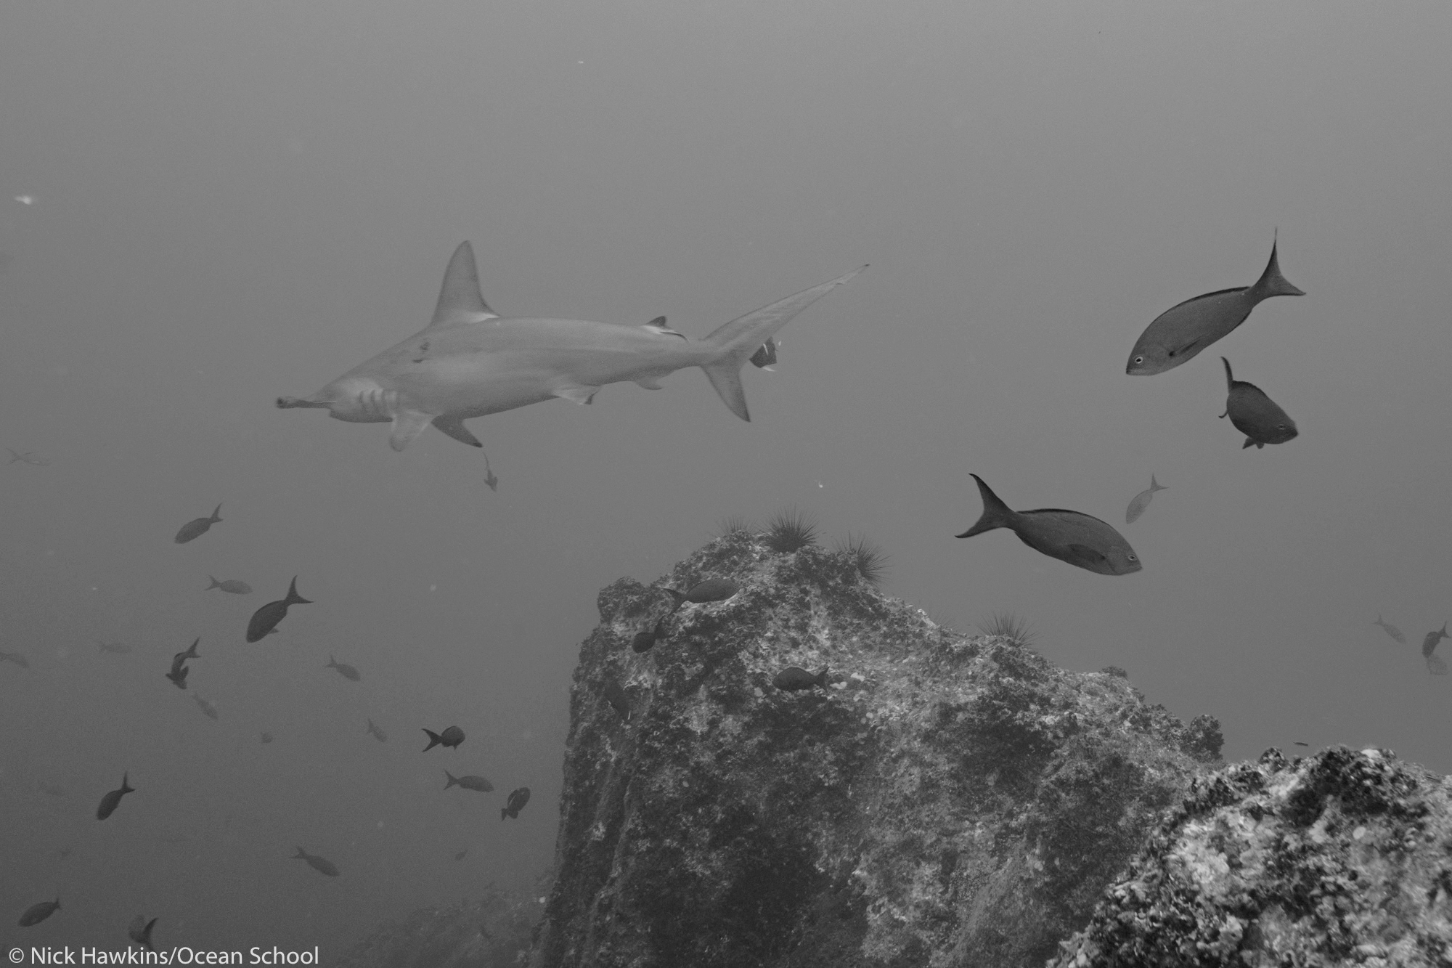
About our sharks
We’re going to be tracking two scalloped hammerhead shark specimens: a male and a female.
Shark A was tagged on July 4, 2018.
He is a male shark, with a total length of 176cm.
Shark B was also tagged on July 4, 2018.
She is a female shark, with a total length of 232 cm.

Slide 10
Hammerhead Shark A - Male
Describe how hammerhead A travels over time.
What environments does this hammerhead prefer? How do you know?

Slide 11
Hammerhead Shark B - Female
Describe how hammerhead B travels over time.
What environments does this hammerhead prefer? How do you know?

Slide 12
Compare the two Hammerhead Sharks
 | Hammerhead A | Hammerhead B
Distance travelled
Preferred locations
[Add your own]

Slide 13
What are you wondering about?
Now that we know where these two sharks like to go, what questions should we ask to figure out why they like to go there?

